Slide 1


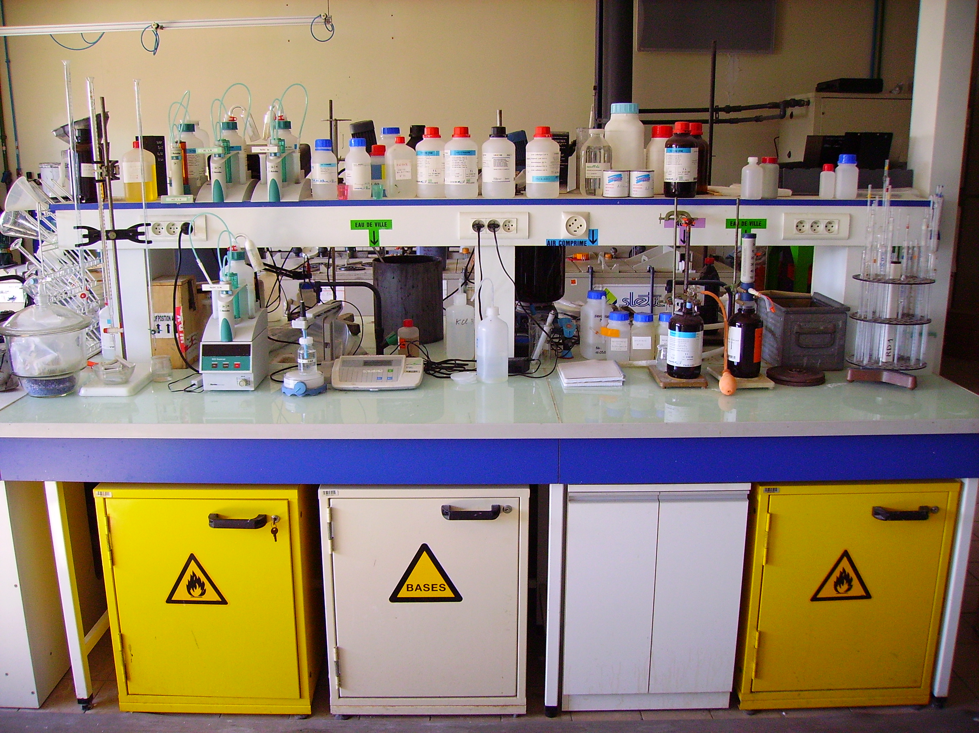
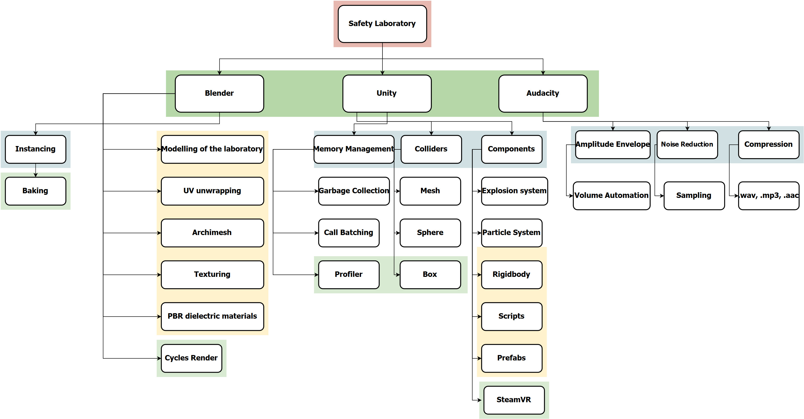
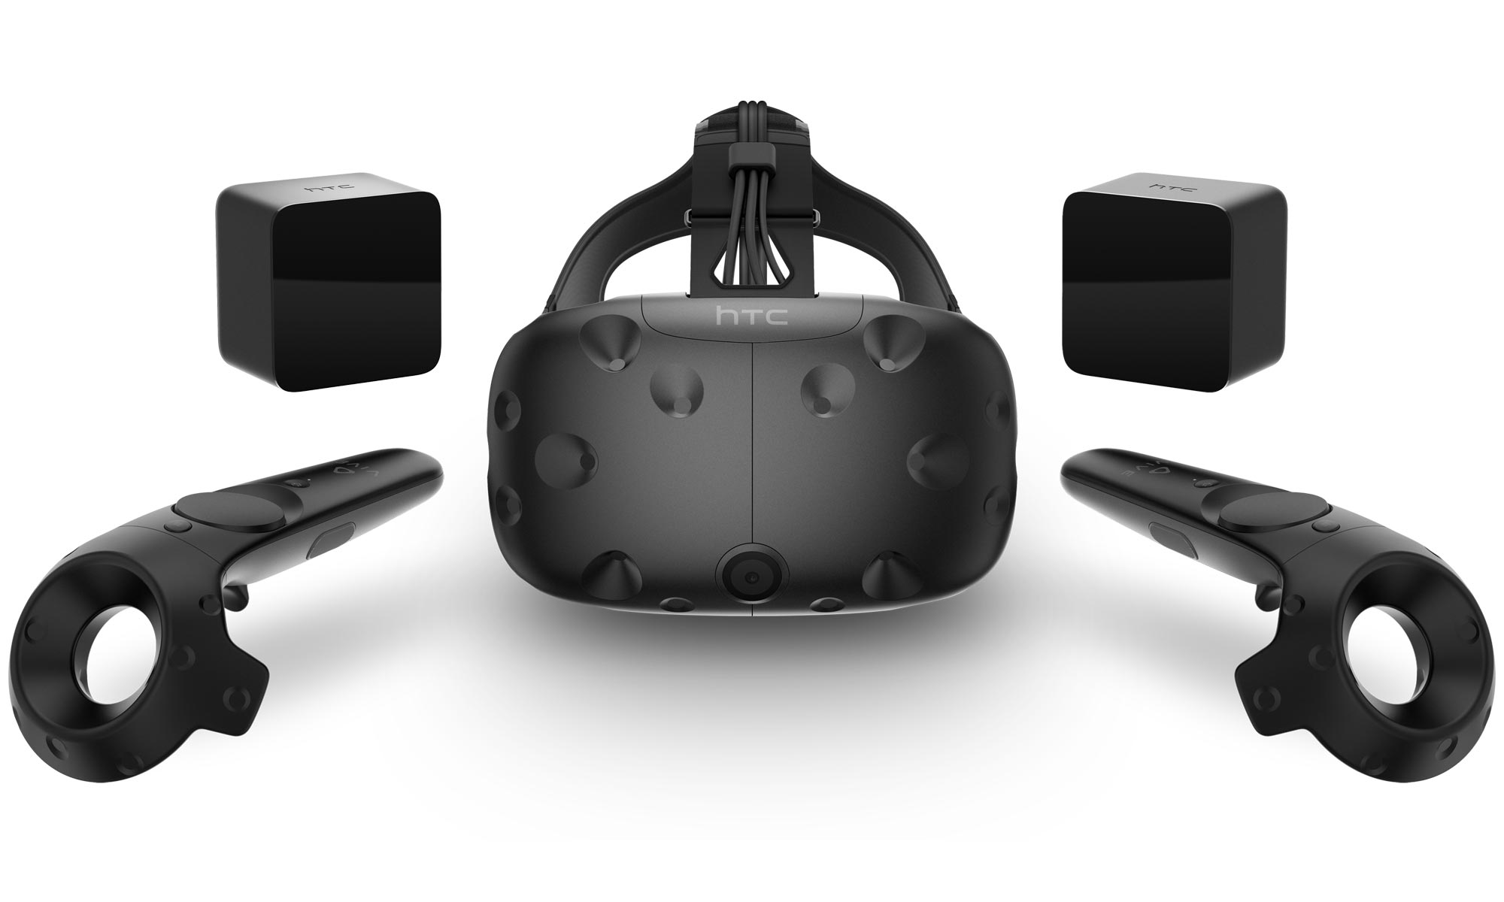
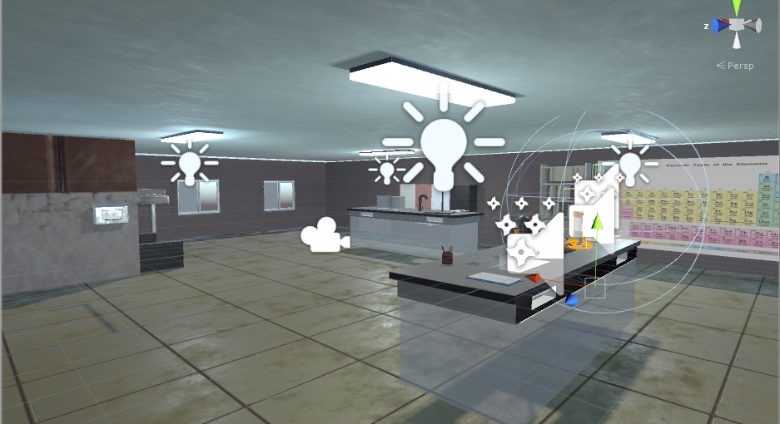
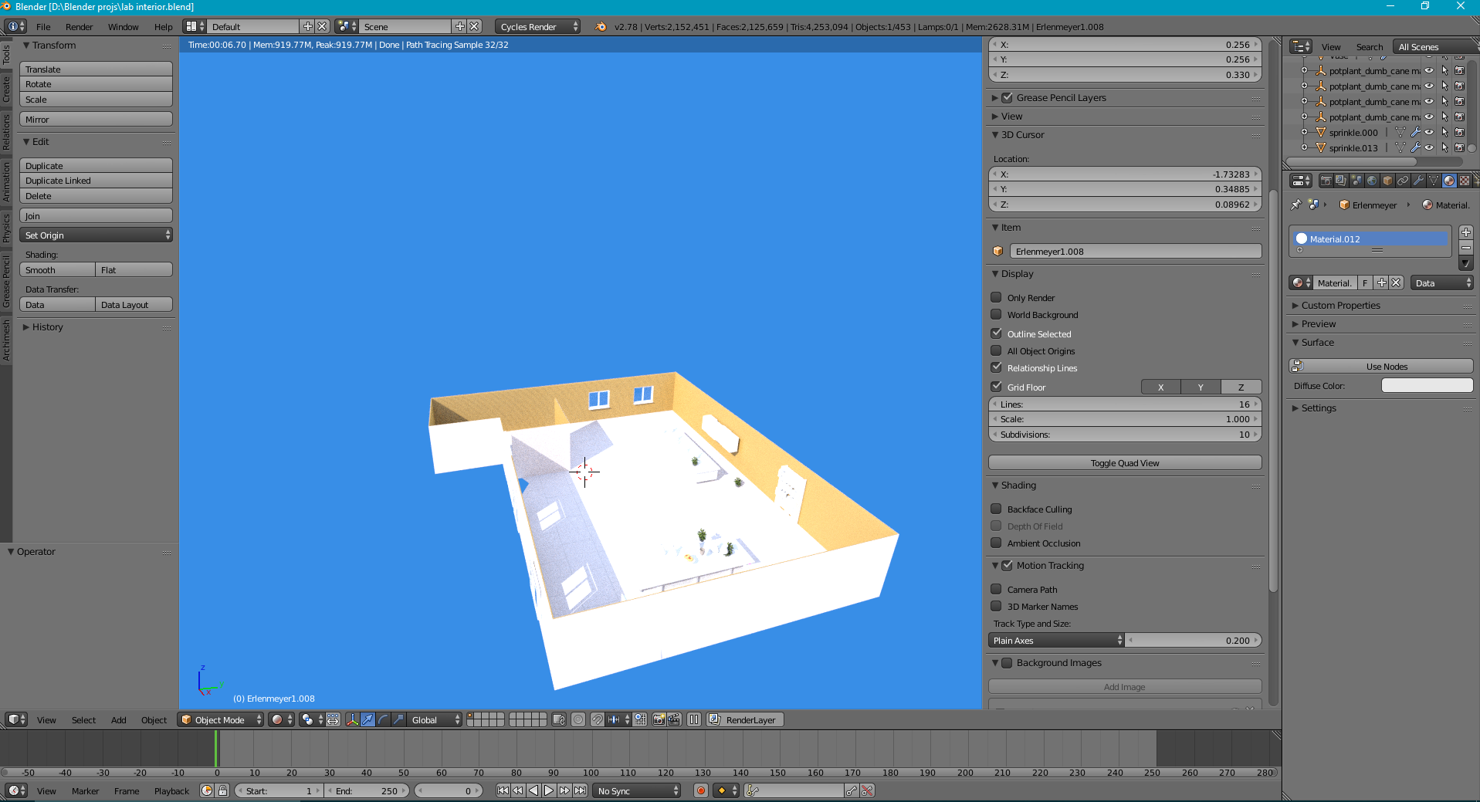
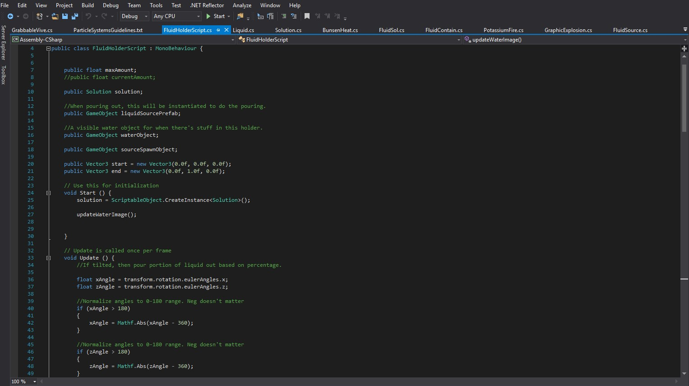
Educational lab in VR
Project No. X.X
Presenters’ name Omar Irfan Khan
Mohammad Eyad Masoud
Department of Computer Engineering, School of Engineering, American University of Ras Al Khaimah
May.7.2017
Introduction
The definition of virtual reality (VR) is derived from both the words ‘virtual’ and ‘reality’. The definition of virtual is near and reality is what we experience as human beings. In technical terms, VR is the terminology used to describe a three-dimensional, computer-generated environment which can be explored and interacted by a person. The person becomes a part of this virtual world or is immersed within this environment and is allowed to perform several actions.
Method
• Identify potential components and choose one of them.
• Start modelling the laboratory via Blender.
• Define other objectives that you need to cover.
• After the creation of the 3D model, transfer it to Unity.
• Add mesh and primitive colliders to prefabs and objects.
• Add Rigidbody to the object which allows it to behave realistically.
• Provide appropriate scripts and libraries to allow debugging and interaction in VR.
• Perform optimizations(Garbage collection, Call batching) to improve the performance of the game.
Figure.4 Block diagram of the system
Figure. 1 Chemistry laboratory
Figure. 2 HTC Vive
Figure. 5 Components flowchart
Figure. 3 Final scene
Blender modelling and Unity scripting
• Each object present in the laboratory will have a certain amount of reflection.
• Depending if they are either diffuse, glossy, glass or anisotropic bidirectional scattering distribution function (BSDF).
Aim
• Develop the relevant apparatus for the laboratory so it can mimic and show the desired results as if the user was using this equipment in real life.
• Construct various sprites and lightning models to create the perfect atmosphere.
• Maintain the memory and graphics usage to optimal levels.
• Develop Rigidbodies and appropriate colliders so that the object functions like how it should in real life.
• Retain a solid 60-75 frame per seconds (FPS) as well as consistently outputs at the desired resolution of the head mounted display (HMD) refresh rate.
• Create scripts that will allow the user to interact with objects around the lab.
• Allow the user to walk around the room and access various areas of the lab given, that it is within the play space area defined by the chaperone system.
Figure. 6 Rendered model
Figure. 7 Fluid holder script
Conclusions
There are always room for improvements. The project can be improved by adding more scenarios portraying health and safety to students such as if a chemical falls on your hand or if you are in contact with a poisonous gas. Also, we can add appropriate fume hoods and ventilation so the laboratory looks more realistic. Moreover, this project is just a proof of concept to show the infinite possibilities of how VR can be used not only in educational training but also, training in general for a number of jobs.
Acknowledgments
Firstly, we would like to express our deepest gratitude to our senior design project advisor Dr. Abdul Halim Jallad who guided us and gave his invaluable advice throughout the project. Without his guidance we may have not been able to go down the right path of development and are indebted to him.
Also, this project would not have been initiated/accomplished without the commitment, resiliency and endeavor of each member. Moreover, we would like to acknowledge the diligent senior design project committee for providing us with the project templates and a step by step explanation of how important each phase is.

